Slide 1
CRAFTING A PERSUASIVE STRATEGY PRESENTATION
Assignment 6

Slide 2
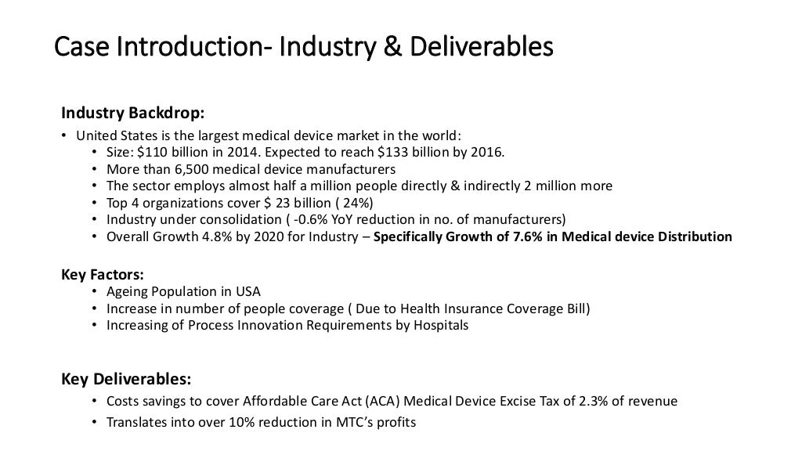

Slide 3
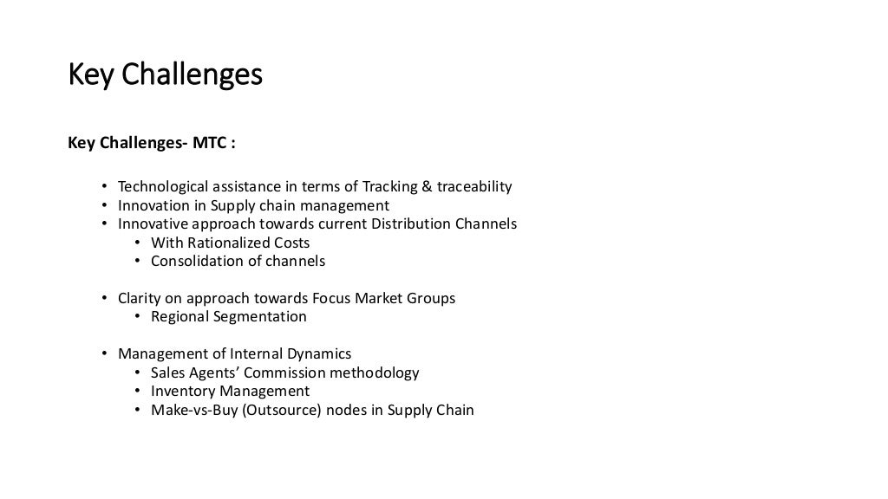

Slide 4
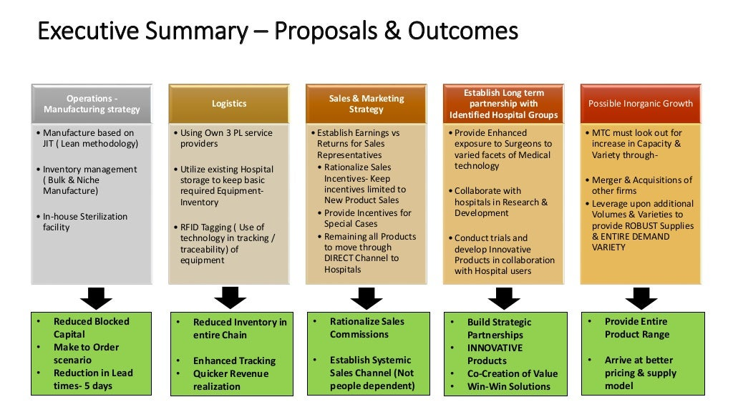

Slide 5
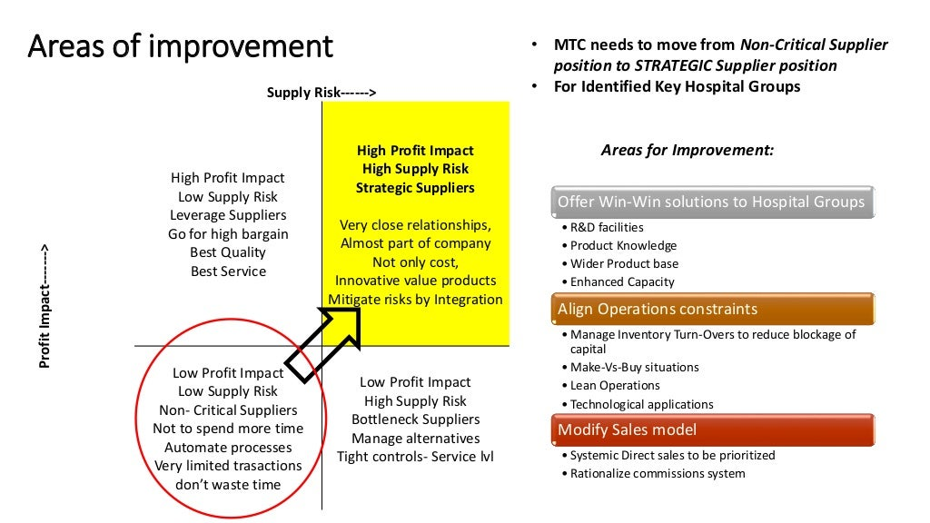

Slide 6
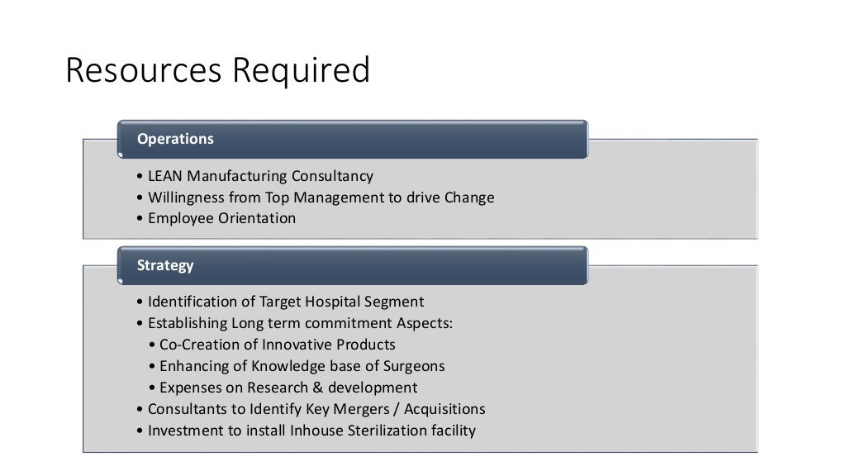

Slide 7
